Slide 1
WAN Connections
Enabling the Internet Connection

Slide 2
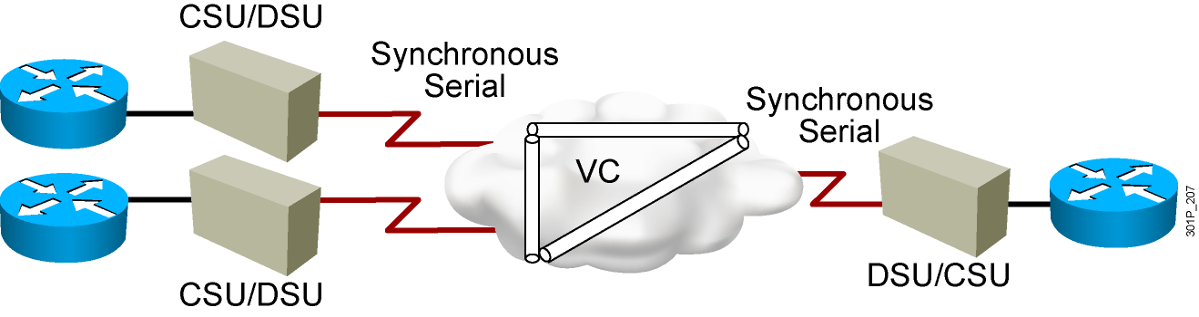
Packet Switching
Notes:
Lesson Aim
<Enter lesson aim here.>

Slide 3
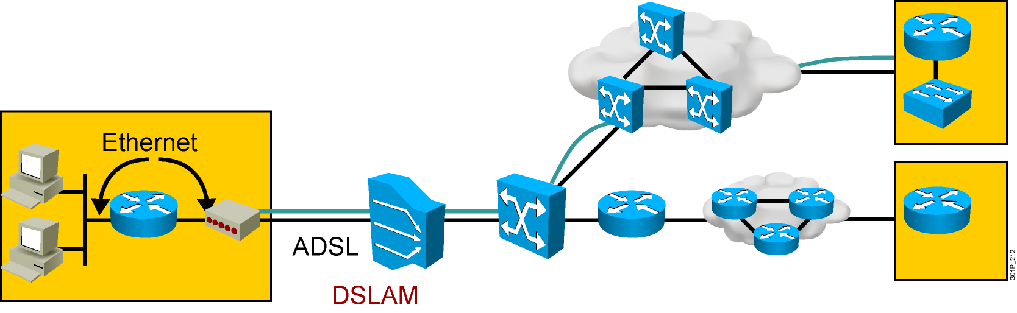
DSL
Notes:
Lesson Aim
<Enter lesson aim here.>

Slide 4
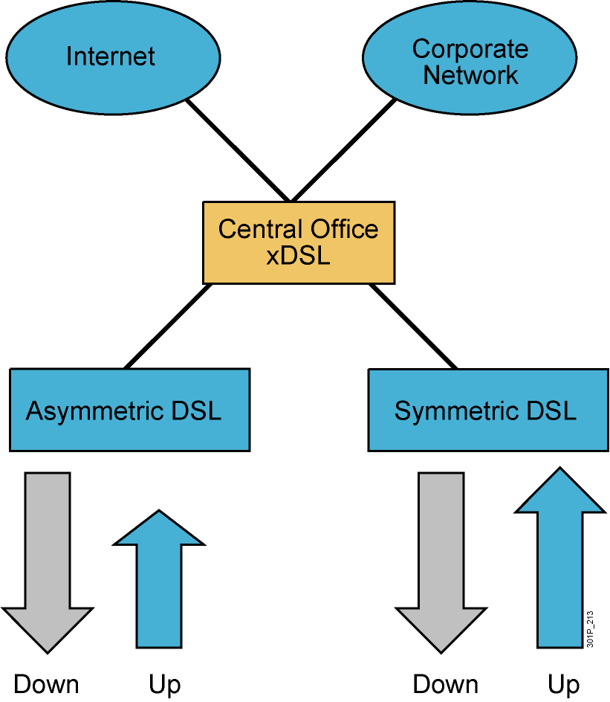
DSL Service Types Overview
Notes:
Lesson Aim
<Enter lesson aim here.>

Slide 5
DSL Considerations
Advantages
  Speed
  Simultaneous voice and data transmission
  Incremental additions
  Always-on availability
  Backward compatibility with analog phones
Disadvantages
  Limited availability
  Local phone company requirements
  Security risks

Slide 6
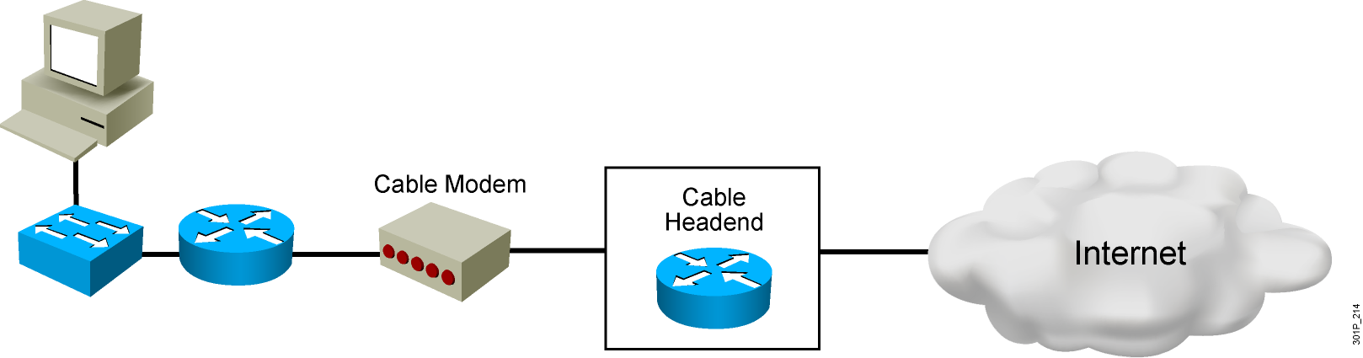
Cable-Based WANs

Slide 7
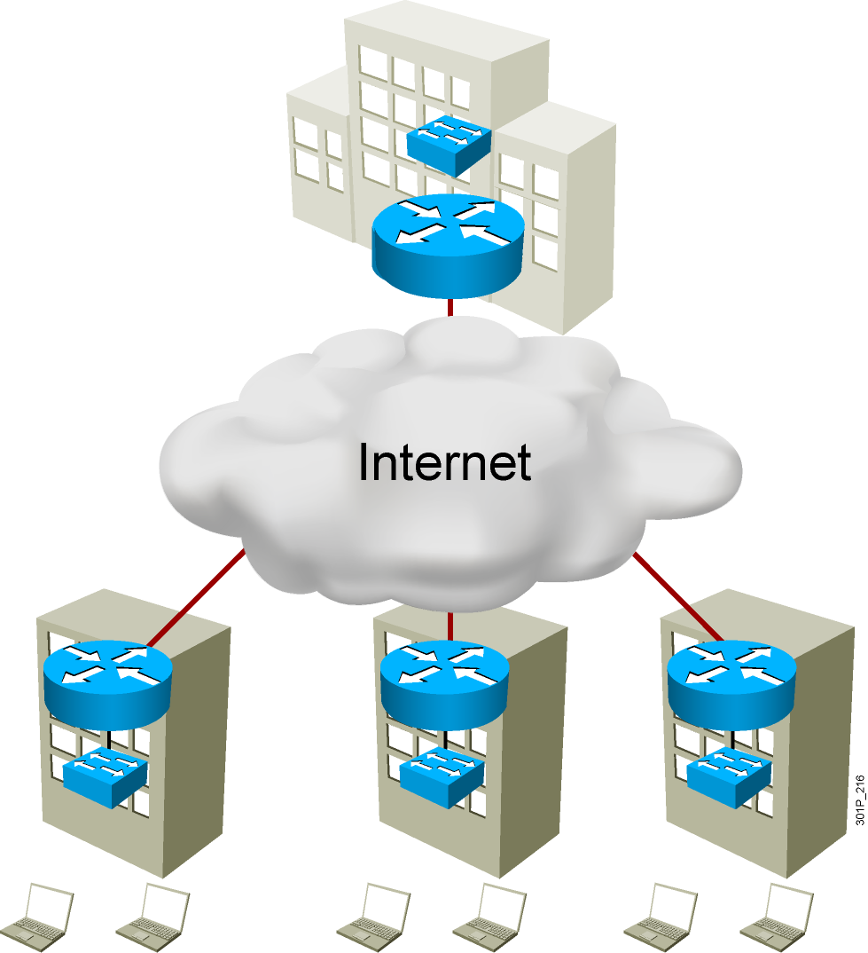
The Global Internet

Slide 8
Getting an Interface Address from a DHCP Server
  No manual IP address is configured on the interface.
  The router operates as a DHCP client.
  The ISP provides DHCP information.

Slide 9
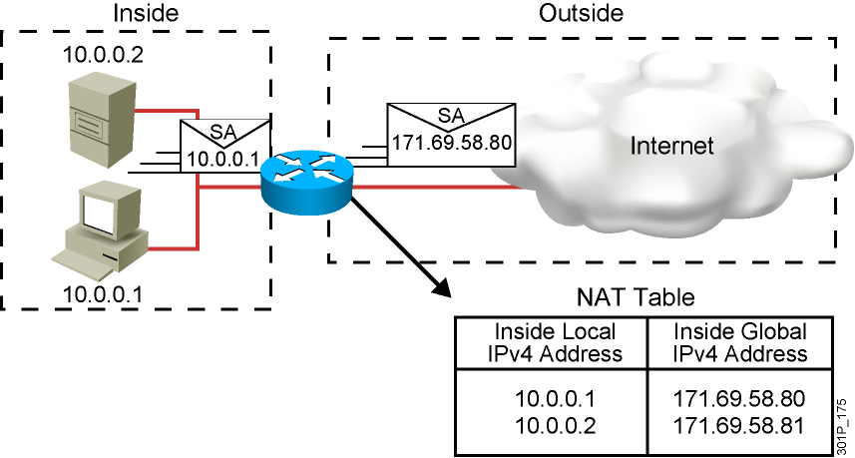
Network Address Translation
  An IP address is either local or global.
  Local IP addresses are seen in the inside network.
  Global IP addresses are seen in the outside network.
  Assignment can be static or dynamic.

Slide 10
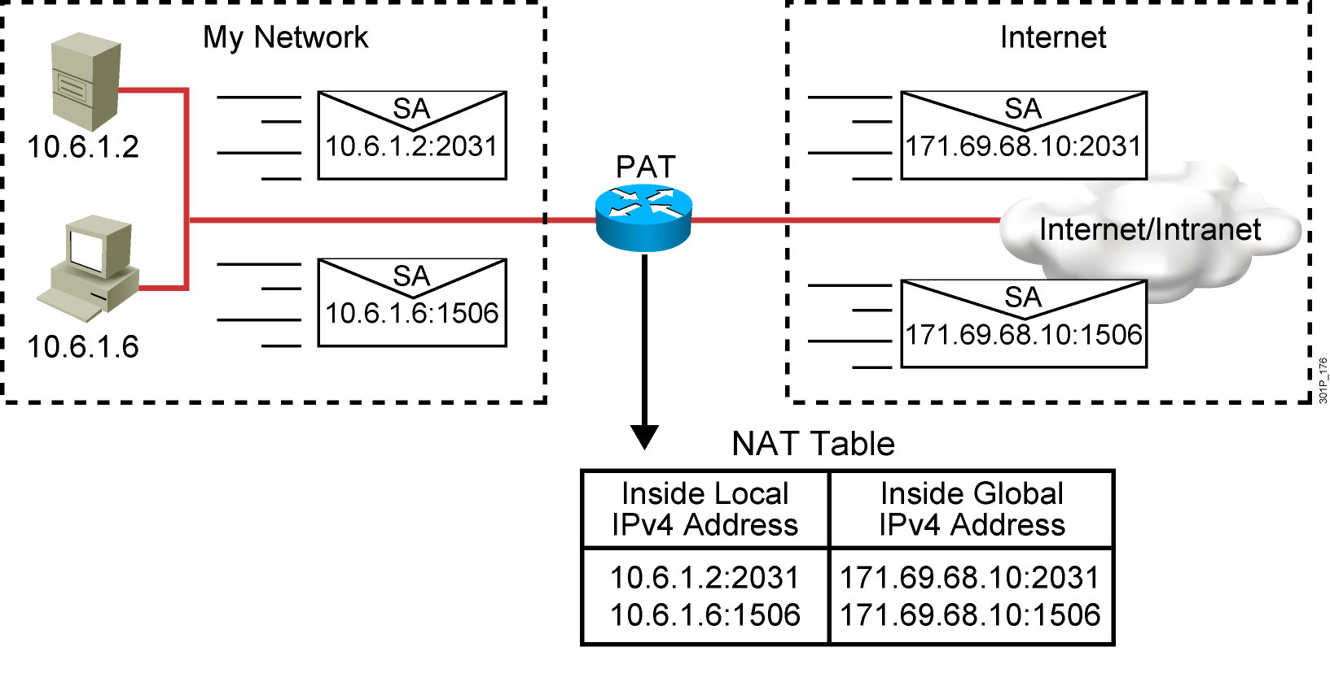
Port Address Translation

Slide 11
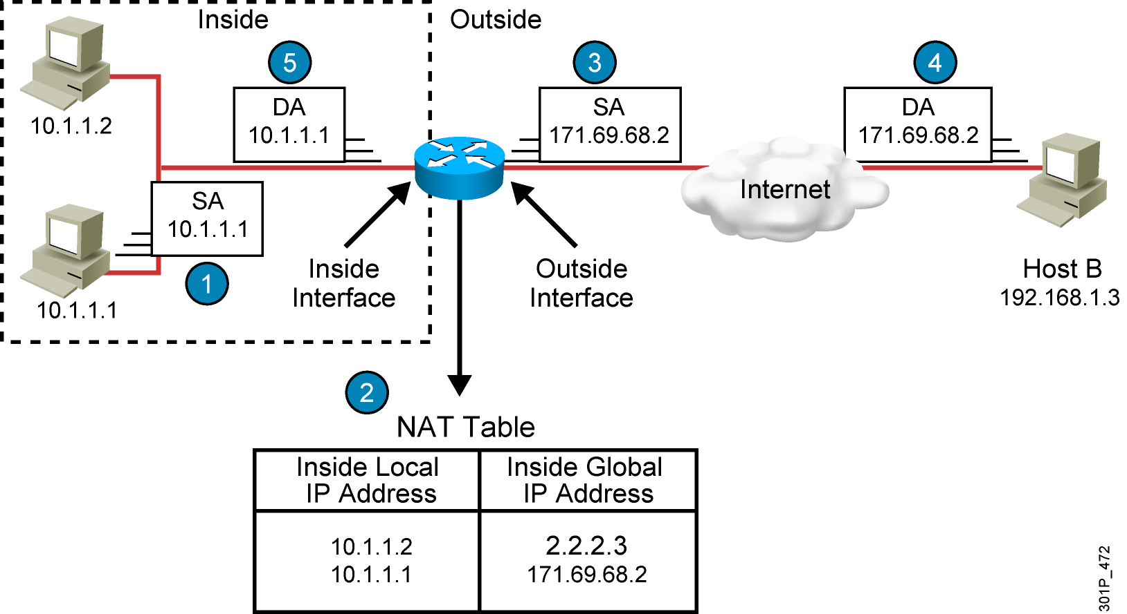
Translating Inside Source Addresses

Slide 12
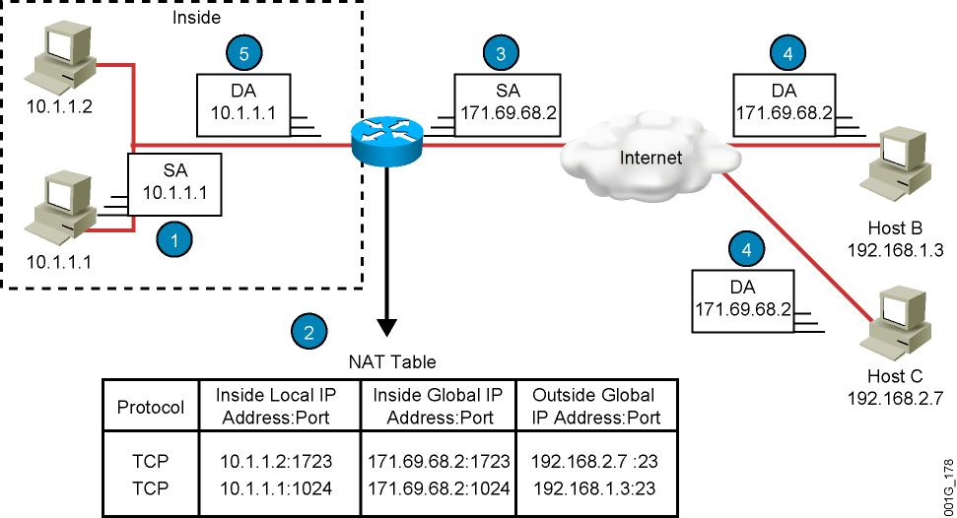
Overloading an Inside Global Address

Slide 13
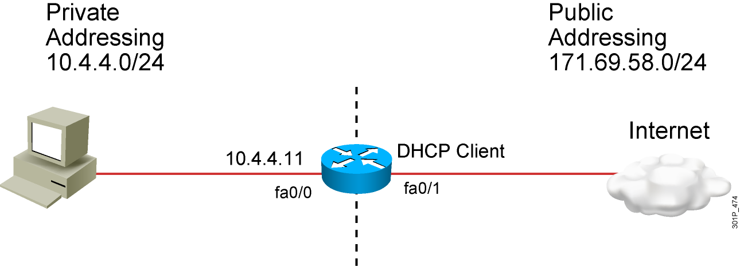
Gathering the Required Information

Slide 14
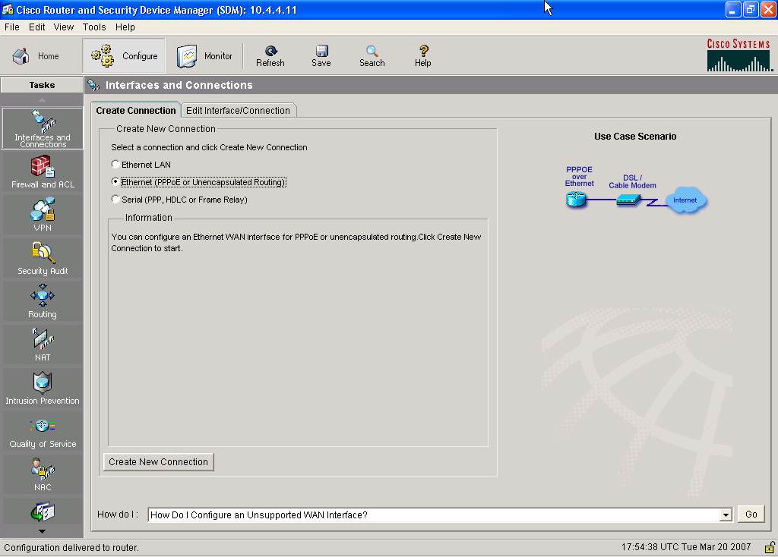
Configuring the Client: Interface and Connection

Slide 16
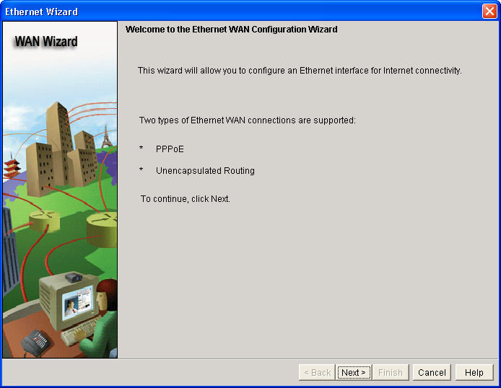
Configuring the Client: WAN Wizard

Slide 18
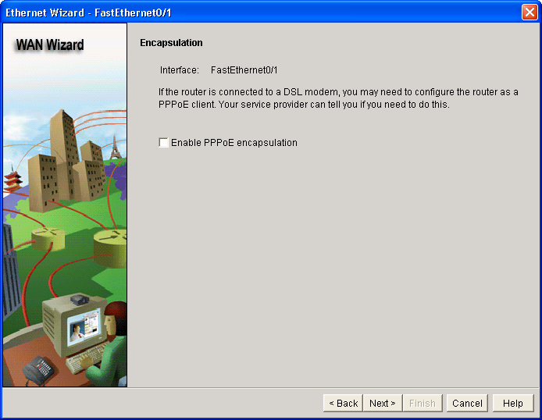
Configuring the Client: Encapsulation

Slide 20
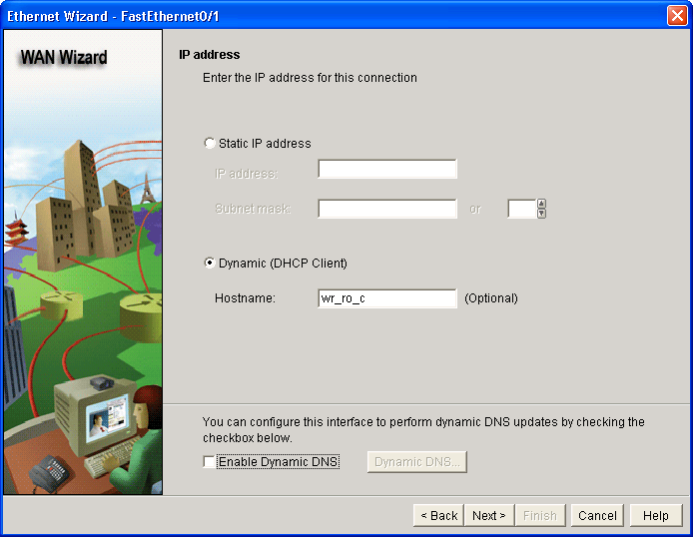
Configuring the Client: IP Addressing

Slide 22
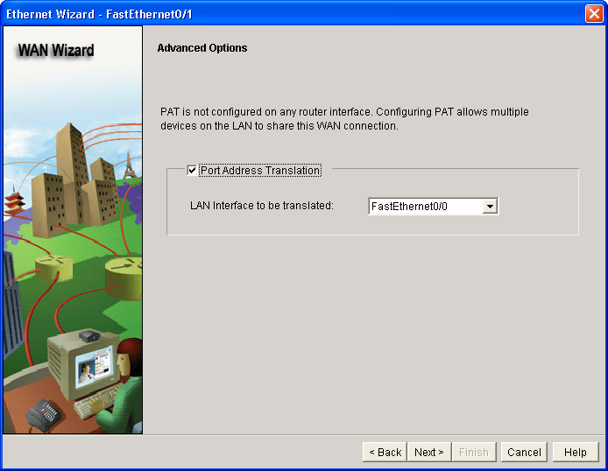
Configuring PAT: Advanced Options

Slide 24
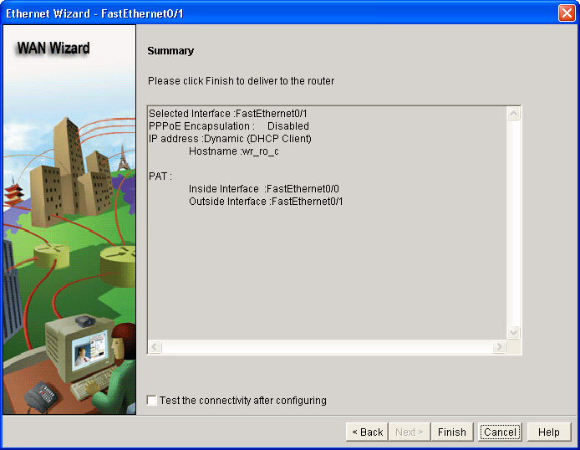
Configuring PAT: Summary

Slide 26
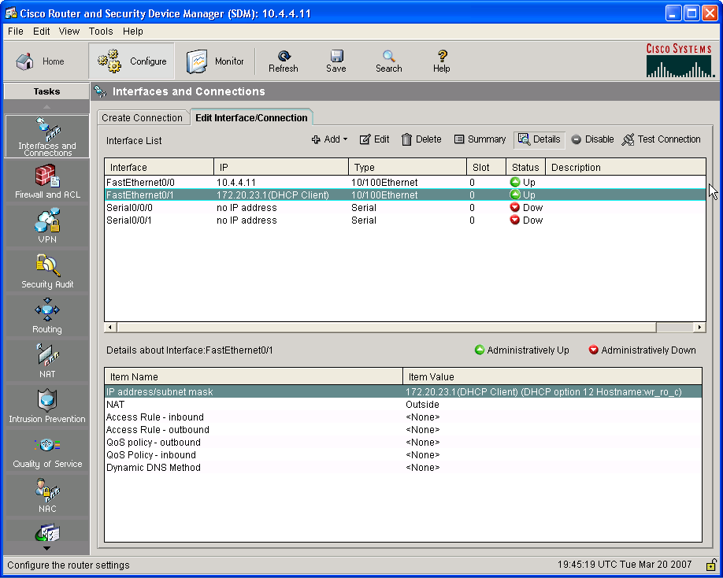
Verifying the DHCP Client Configuration

Slide 28
Displaying Information with show Commands
RouterX# show ip nat translation
Pro Inside global Inside local Outside local Outside global
--- 172.16.131.1 10.10.10.1 --- ---
  Displays active translations
RouterX# clear ip nat translation *
  Clears all dynamic address translation entries

Slide 29
Summary
  Packet-switched networks send data packets over different routes of a shared public network owned by a carrier to reach the same destination. The route that the packets take to reach the destination site, however, will vary.
  There are several varieties of DSL, including ADSL, SDSL, HDSL, IDSL, and CDSL. There are both advantages (speed, always on, and so on) and disadvantages (availability)
  to DSL.
  Cable access to the Internet has become a higher-speed alternative to DSL and serial.
  The global Internet grew from a U.S. Department of Defense plan to build a command-and-control network in the 1960s to its present state as the largest WAN on earth, with multiple ways to access it and multiple communication, research, and commercial uses.
  An interface can obtain its IP address from a DHCP server.

Slide 30
Summary (Cont.)
  NAT enables private IP internetworks that use unregistered IP addresses to connect to the Internet. PAT, a feature of NAT, enables several internal addresses to be translated to only one or a few external addresses.
  You can translate your own IP addresses into globally unique IP addresses when communicating outside of your network.
  Overloading is a form of dynamic NAT that maps multiple unregistered IP addresses to a single registered IP address (many-to-one) by using different ports, known also as PAT.
  After NAT is configured, the clear and show commands can be used to verify that it is operating as expected.
Notes:
Purpose: This slide discuss the initial configurations on the routers and switches.
Note: There is no setup mode on the Catalyst 1900 switch.

